Slide 1
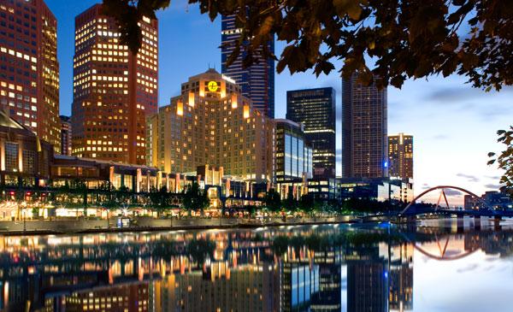
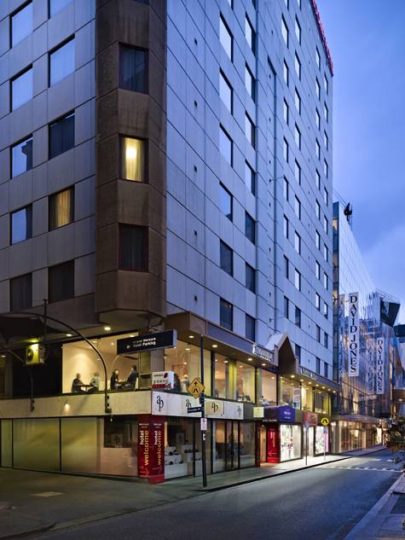
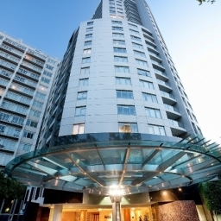
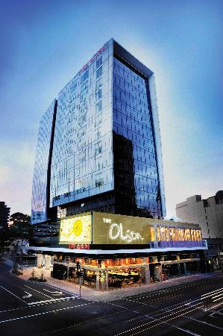
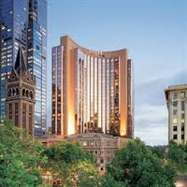
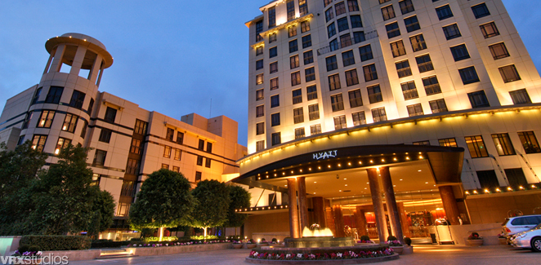
Now imagine that a relative is coming to Melbourne for a weekend. He/she likes to find a hotel which is both, nearest to the airport and also the cheapest.
Below you see six different offers from hotels in and around Melbourne. By clicking on those offers you can get more information about them. Please click on the hotel you would recommend to your friend.
Special Offer!!
Travellers‘ Choice 2013 Winner
The Langham
Grand Mercure
Brand new swimming pool
Quay West Suites
NEW!!
Art Series – The Olsen
Grand Hyatt
Park Hyatt

Slide 2
Travellers‘ Choice 2013 Winner
Langham Hotel Melbourne extends a most enchanting invitation
Experience the incomparable hospitality of the original Langham grand hotel, now reinterpreted in Melbourne as The Langham Melbourne hotel. Voted for the fourth consecutive year, winner of the Travel + Leisure Magazine USA 'World's Best Awards Readers' Survey' as the top city hotel in Australia, New Zealand and the South Pacific.
The legendary service of The Langham, Hotel Melbourne positions it as a jewel among Melbourne Accommodation. Its enviable riverside location further enhances the allure of this exceptional Melbourne conference and meeting venue and is only twenty-seven kilometers away from the airport.
Allow us to introduce you to the many wonders of The Langham Melbourne hotel with our Melbourne accommodation packages. Indeed, our remarkable features and facilities - many of them unique to us - are what make this a most extraordinary Melbourne hotel. The price for a weekend stay is only 389$.
We greatly anticipate the pleasure of your company at The Langham Melbourne hotel.

Slide 3
Park Hyatt
Overlooking St. Patrick’s Cathedral, Fitzroy Gardens and the cosmopolitan mix of Victorian and modern architecture of the central business district, Park Hyatt Melbourne offers an exclusive sanctuary in the heart of the city. Our 5-star luxury hotel in Melbourne CBD provides a warm ambience and exceptional levels of personalised service and luxury amenities. We offer a weekend stay for 329$.
Renowned for having the largest 240 luxury rooms & suites in Melbourne with walk in robes, Italian marble ensuites and open windows, our luxury hotel in Melbourne provides an unparalleled experience of elegant, contemporary luxury. Guests are invited to enjoy the award-winning ‘radii’ restaurant & bar, a decadent Tea Lounge and our local-favourite day spa featuring an indoor aquamarine pool, spa, sauna, gym and private sun deck.
The hotel also offers a beautiful range of event spaces of varying size and design and caters for anything from intimate and private gatherings to corporate events for up to 450 people. The hotel also specialises in weddings offering a wedding planner, wedding packages, personalised menus and a range romantic rooms and suites.
Our luxury Melbourne hotel is near the Melbourne Cricket Ground (MCG), home of the Australian Football League (AFL) and test cricket. It is also within walking distance to the Melbourne Museum, featuring the stunning exhibition The Wonders of Ancient Mesopotamia, and the best boutique shopping, cafes, restaurants and theatre districts in CBD. Melbourne Airport is conveniently located only 23km away.

Slide 4
Grand Mercure
Mercure Welcome Melbourne hotel offers you affordable budget accommodation and a base from which to explore all the attractions and events in Melbourne city and the CBD (24 kilometers from the airport).
Melbourne is undoubtedly Australia’s best destination for shopping, dining, drinking, entertainment and sport – so your hardest decision on holiday will be…"what shall I do today?" Fortunately, staying in the hotel you'll be right in the heart of all this and more - you'll have direct access to all the best things to do in Melbourne city!
You'll love our modern 3.5 star hotel accommodation, providing you with comfort, convenience, and great-value, budget rates (415$ per weekend) that leave you more to spend on Melbourne city's many attractions!

Slide 5
Special Offer!!
Travellers‘ Choice 2013 Winner
Quay West Suites
Located on cosmopolitan Southgate (28 km from the airport) the property is ideally located adjacent to some of Melbournes ideal shopping restaurants and Arts Precinct. Combining both the luxury of 5 star hotel services and facilities with a fully self contained suite Quay West isperfect for that overnight stay or for that longer period. Enjoy the ambience of Jarrah Restaurant and Bar or luxuriate in our indoor 15 metre pool spa sauna and gym.
The hotel is a stylish Southbank hotel set amongst the picturesque Southbank promenade, overlooking the Yarra River. A leisurely stroll from Melbourne's CBD & within walking distance to the major Melbourne attractions.
Quay West Suites Melbourne features 100 one, two or three bedroom Melbourne serviced apartment suites ideally positioned in Southbank promenade. If you book today, you do not pay more than 349$ for a one weekend stay. Facilities include: Valet grocery service, 24-hour reception, in-suite dining and concierge. A stunning heated indoor swimming pool, spa, sauna, fully equipped gymnasium, valet parking and the dining delights of Jarrah Restaurant & Bar.

Slide 6
Art Series – The Olsen
At The Olsen Hotel, one can sleep soundly on Art Series Signature bedding, plunge into the spectacular glass bottom pool with Chapel Street shoppers below, work out in our state-of-the-art gymnasium or step out for some retail therapy. These South Yarra accommodations offer plentiful natural light and are thoughtfully appointed with 42” flatscreen televisions, wireless internet access and complete kitchenettes.
Set on Melbourne’s prestigious Chapel Street (31 km to the airport), The Olsen Hotel offers travelers premier South Yarra accommodation with 229 elegant five-star suites that are infused with the lyrical works of revered Australian Landscape artist Dr John Olsen. Breathtaking mural and sculpture greet you on arrival and large prints adorn all hallways and suites. This boutique Melbourne hotel is complimented by a day spa and two delicious restaurants; you will be reveling in the Art of [Creature Comforts].
The Olsen Hotel in Melbourne is complete with first class facilities and a range of services to ensure every aspect of your stay is taken care of. Enjoy five star service and the facilities in and around the hotel, including 24 hour reception, concierge and room service, secure luggage storage area, conference and event facilities, Day Spa
Hair Salon and iPod rental with extensive play lists.
Book today for only 359$ a weekend!

Slide 7
NEW!!
Travellers‘ Choice 2013 Winner
Grant Hyatt
Grand Hyatt Melbourne hotel is a 5-star hotel on Collins Street in the centre of CBD, business, luxury shopping, theatre and restaurant district. The hotel is located within walking distance of Princess Theatre, Federation Square and Southgate, 25 kilometres from the airport.
The hotel provides 544 rooms and suites with extensive meeting rooms and event facilities, spectacular upper and lower lobbies, the restaurant, Collins Kitchen, the bar, RU-CO, as well as an exclusive retail environment and innovative events venue, the residence.
Guests booking into Club accommodation (399$/weekend) will enjoy all the benefits of the Grand Club lounge including personalised express check in and check-out, deluxe continental breakfast, all day refreshments, evening drinks with canapés and private meeting areas. For meetings and events, Grand Hyatt Melbourne offers the perfect combination of first-class function rooms, outstanding services and a range of flexible packages. For weddings our Melbourne hotel offers a range of romantic rooms for your special day. Grand Hyatt Melbourne also offers all guests’ access to City Club Health & Fitness and exclusive spa treatments and massages at our Sanctuary Day Spa.

Slide 8
Solution ☺
Travellers‘ Choice 2013 Winner
Price: 389$
Distance: 27km
Price: 415$
Distance: 24km
Price: 349$
Distance: 28km
The Langham
Brand new swimming pool
Grand Mercure
Quay West Suites
Price: 359$
Distance: 31km
Price: 329$
Distance: 23km
Price: 399$
Distance: 25km
Art Series – The Olsen
Park Hyatt
Grand Hyatt

